Slide 1
Problem-solving process

Slide 2
Problem solving
Problem Solving - refers to the entire process of taking the statement of a problem and developing a computer program that solves that problem.
Computers are only as good as their hardware, their software, and the people using them!

Slide 3
Analyzing the Problem
Understand requirements:
The given data (Input)
The required results (Output)
The processing that is required in the problem (Processing)
A list of solution alternatives

Slide 4
Input, Processing, and Output
Three steps that a program typically performs:
Gather input data:
from keyboard, from files on disk drives, etc.
Process the input data
Display the results as output:
send it to the screen
write to a file
Send it to the printer, etc.
We need to print the result of the flowing equation:
C = a x b
Result
Output
Input

Slide 5
Problem solving methods
2 problem solving methods will be discussed during this semester based on algorithms:
Pseudo code: Pseudocode is a semiformal, English-like language with limited vocabulary that can be used to design & describe algorithms.
Flowchart: Graphically depicts the logical steps to carry out a task and shows how the steps relate to each other.

Slide 6
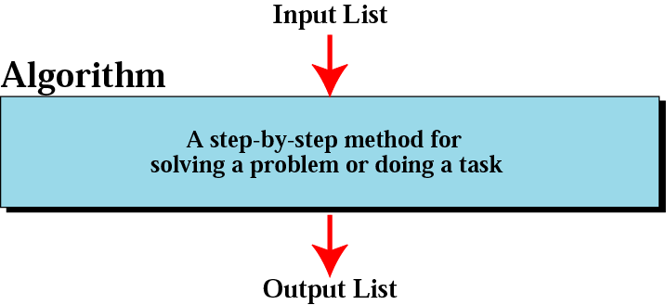
Informal definition of an algorithm used in a computer

Slide 7
Algorithms
Algorithm - a sequence of a finite number of steps arranged in a specific logical order to produce the solution for a problem.
Algorithms requirements:
Must have input
Must produce output
Unambiguous
Generality
Correctness
Finiteness
Efficiency
Notes:
عمومية صحة محدودية نجاعة

Slide 8
Pseudo code
Example: Algorithm for adding two numbers:
1. Start
2. Get A
3. Get B
4. Calculate result
C=A+B
5. Display result C
6. End
Execution
Sequence

Slide 9
Pseudo Code Exercise 2.1
Write an algorithm in pseudocode that finds the average of two numbers

Slide 10
Pseudo Code Exercise 2.2
You need to calculate your average grade for Problem solving course.
There are three marks midterm(30%), quiz (20%) and final (50%).
All the marks are /100
Write pseudo code to calculate your score.

Slide 11
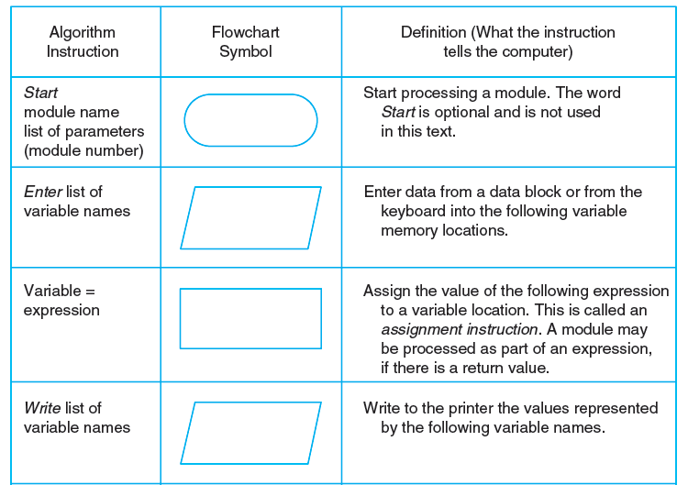
Flowchart

Slide 12
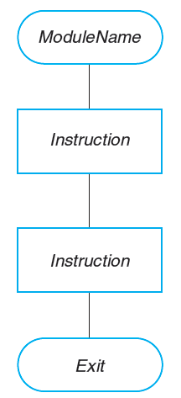
Flowchart Diagram

Slide 13
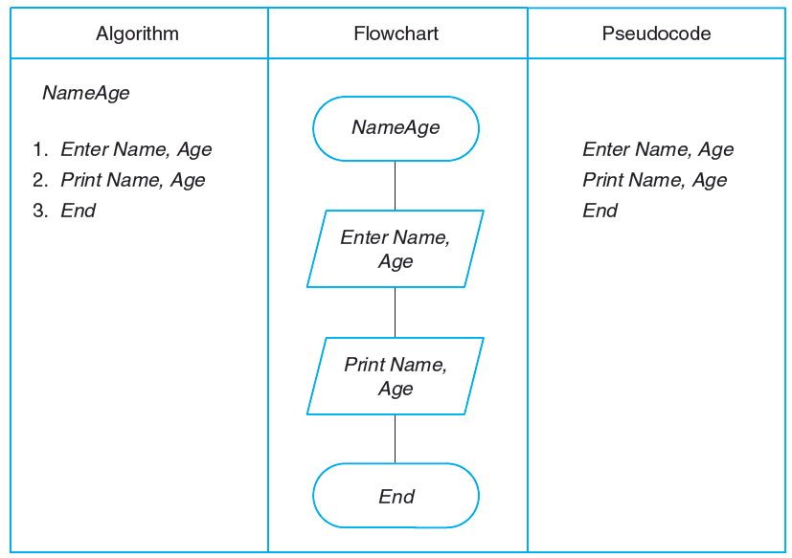
Algorithm, Flowchart, and Pseudocode to Enter and Print Two Variables

Slide 14
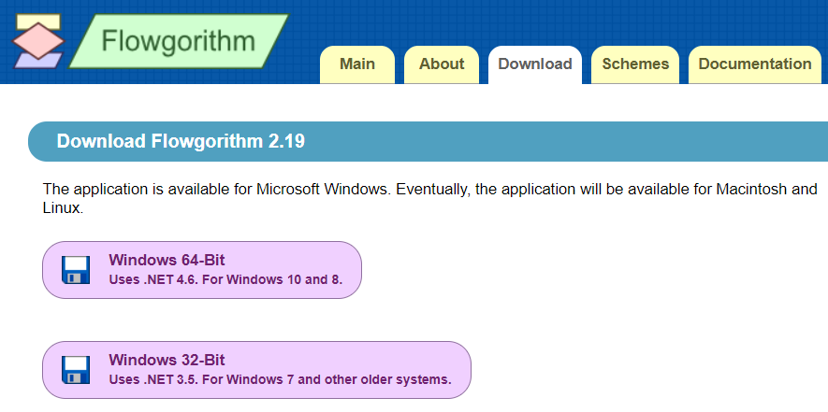
Flowchart software : Flowgorithm http://www.flowgorithm.org/download/index.htm

Slide 15
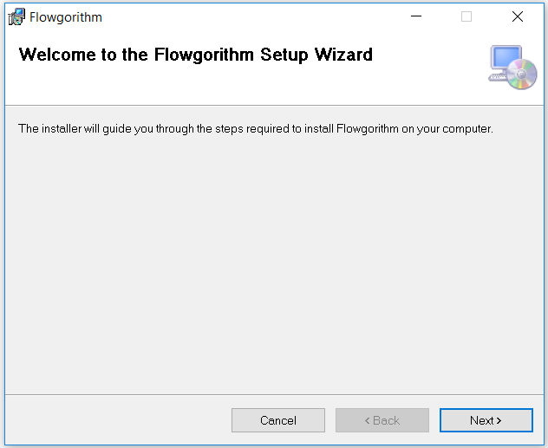

Slide 16
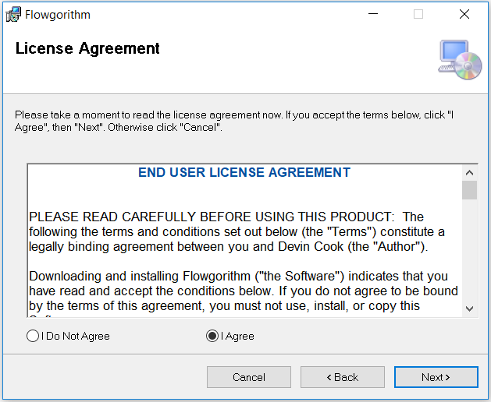

Slide 17
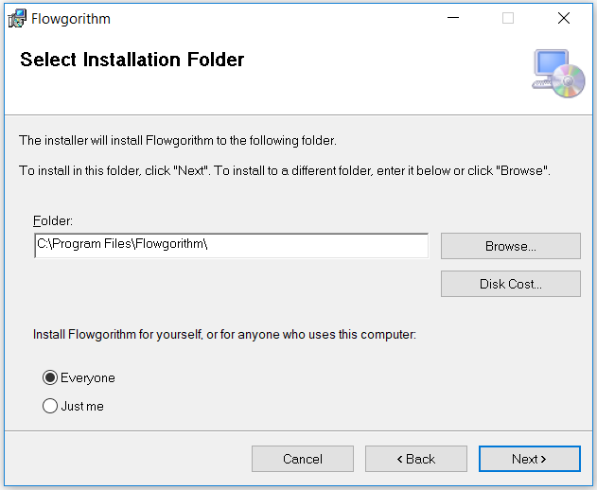

Slide 18
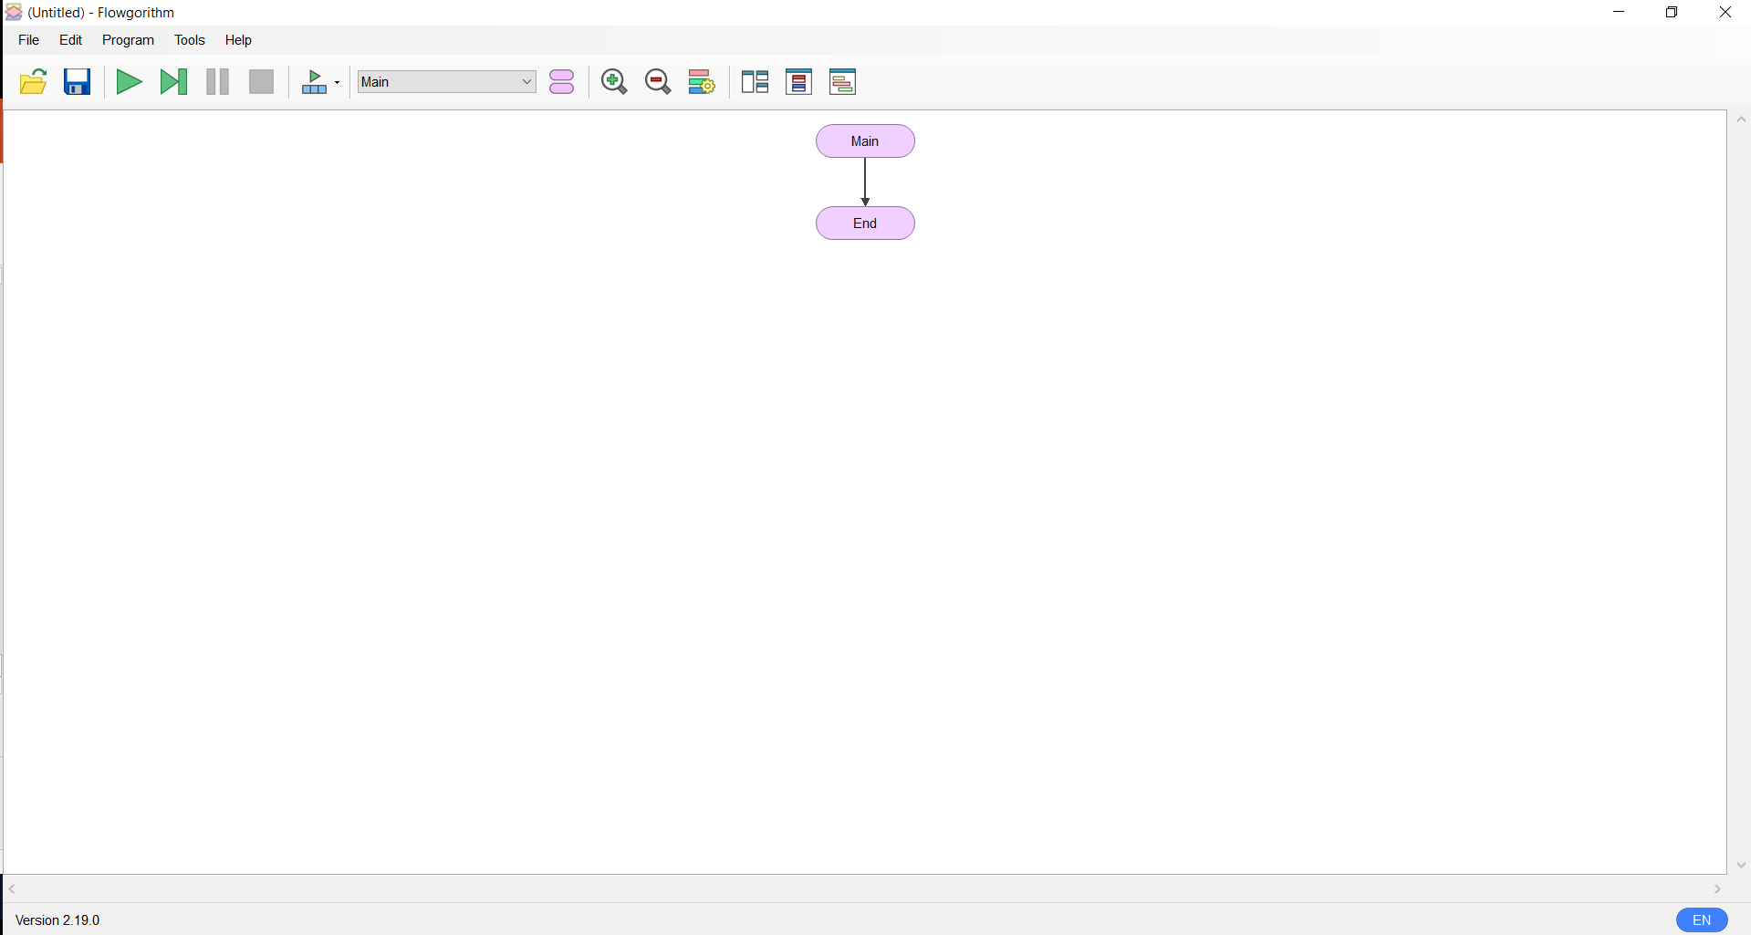

Slide 19
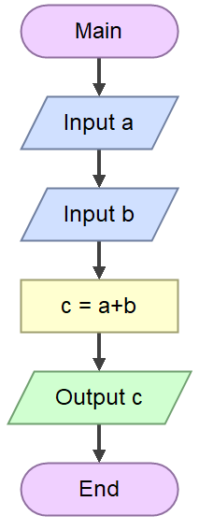
The Flowchart Explanation
Start Terminal.
Program start here
Input.
Enter value for a
Input.
Enter value for b
Process
Output
Stop Terminal
Program end here

Slide 20
Exercise 2.3
Write the pseudo code and flowchart to resolve the following equation
3x+b=c

Slide 21
Exercise 2.4
Write a pseudo code and draw the flowchart to calculate the area and the perimeter of rectangle.

